Slide 1
Unit IV: Fuel Topic: Solid fuel(Coal),
proximate analysis of coal
Dr. P. G. Umape
PUNE INSTITUTE OF COMPUTER TECHNOLOGY

Slide 2
Analysis of Coal
Learning outcome:
Student should understand need for analysis of coal.
Student should be able to calculate % moisture, % Volatile mater, % Ash and % fixed carbon content in a coal sample.
Student should have knowledge of different analytical parameter and their significance.

Slide 3
Analysis of Coal
The coal can be analyzed by two methods
Proximate analysis
Ultimate analysis
There is a need of coal analysis in order to decide
Quality of coal
Price of coal
Use of coal
To calculate theoretical calorific value

Slide 4
Analysis of Coal
The results of analysis are generally reported in the following ways:
As received basis
Air dried basis
Moisture free basis (oven dried)
Moisture and ash free basis

Slide 5
Proximate Analysis
When coal is analysed to determine % moisture, % Volatile matter, % Ash and % fixed carbon content
% Moisture:
When coal sample is heated at 110 ºC for 1 hour in an oven, then total moisture content from the coal can be removed.
Procedure:
Take powdered coal sample in a pre-weighted crucible having mass W₁ g
The weight of crucible + coal is W₂ g.

Slide 6
Proximate Analysis
% Moisture:
Heat this coal sample in an oven at 110 ºC for 1 hr.
Take out the crucible and cool to room temperature in a descicator
After removing moisture W₃ is the weight of crucible + coal
From the experiments we have
Weight of Coal = (W₂-W₁) g
Weight of moisture = (W₂-W₃)g
Weight of moisture X 100
% Moisture =
Weight of coal
(W₂-W₃) X 100
% Moisture =
(W₂-W₁)

Slide 7
Proximate Analysis
% Volatile Matter:
When a coal sample is heated at 925 ºC for 7 minutes, then all the volatile matter content from the coal can be eliminated.
Coal consist of carbon containing molecules that does not undergo combustion but leads to thermal degradation to form volatile matter.
Procedure:
Crucible containing coal sample after removal of moisture is covered with lid loosely and kept in muffle furnace at 925 ºC for 7 minutes.

Slide 8
Proximate Analysis
% Volatile Matter:
Procedure:
Remove the coal sample and cool in descicator
Check the weight of crucible + coal after removal of volatile matter consider it as W₄ g
From the experiments we have
Weight of Coal = (W₂-W₁) g
Weight of coal after removing volatile matter =(W₃-W₄) g
Weight of Volatile matter X 100
% Volatile Matter =
Weight of coal

Slide 9
Proximate Analysis
% Volatile Matter:
The volatile matter content can be also calculated by taking fresh coal sample in that case formula will be
(W₃-W₄) X 100
% Volatile matter =
(W₂-W₁)
Weight of
moisture and volatile matter X 100
% Volatile Matter =
− % Moisture
Weight of coal
(W₂-W₄)X 100
% Volatile Matter =
− % Moisture
(W₂-W₁)

Slide 10
Proximate Analysis
% Ash:
When coal is heated at 750 ºC for 30 minutes in muffle furnace, then coal undergoes complete combustion and the residue remained is called as ash.
It is the inorganic matter in coal gets oxidized to form metal oxide and silica, which is non-combustible and left as ash.
Procedure:
Take the coal sample after removal of volatile matter
Heat the sample at 750 ºC for 30 minutes in muffle furnace

Slide 11
Proximate Analysis
% Ash:
Procedure:
After 30 minutes remove the crucible and cool the residue to room temperature in descicator.
Check the weight of crucible + residue, consider W₅ g
Ash content can be also calculated by taking fresh coal sample and following the procedure.
From this procedure we have
Weight of coal sample = (W₂-W₁) g
Weight of residue = (W₅-W₁) g

Slide 12
Proximate Analysis
% Ash:
Weight of ash X 100
% Ash =
Weight of coal
(W₅-W₁) X 100
% Ash =
(W₂-W₁)
% Fixed carbon
% Fixed carbon= 100 − [% moisture + % Volatile matter + % Ash]

Slide 13
Significance of Proximate Analysis
% Moisture:
Moisture content in a coal sample should be low
It decreases calorific value
Increases ignition temperature
Affect smooth combustion of fuel
% Volatile matter:
Volatile matter content in a coal should be low
Decreases calorific value
It leads to environment pollution
Elongates flame
Decreases flame temperature

Slide 14
Significance of Proximate Analysis
% Ash:
Ash content in a coal sample should be low
It decreases calorific value
At high temperature it fuses to form clinker which block air flow
Disposal of ash is a problem
% Fixed carbon:
Fixed carbon content in a coal should be high
Higher the fixed carbon higher will be the calorific value
Higher will be the quality of coal
Such coal on combustion gives low polluting gases

Slide 15
Thank You

Slide 16
Carbonization of Coal (Manufacture of Coke)
It is the process of heating the coal in absence of air to a sufficiently high temperature, so that the coal undergoes decomposition and yields a residue which is richer in carbon content than the original fuel.
Caking and coking of coals: some coals have a tendency to soften and swell at higher temperatures, to form a solid coherent mass with porous structure. Such coals are called caking coals. The residue formed is called coke. If the coke is hard, porous and strong, than the coal, from which it is formed, it is called coking coal. All coking coals are caking coals but all caking coals are not coking coals.
This property is found only in bituminous type of coal.

Slide 17
Ultimate Analysis of Coal
To determine % of elements present in coal
% C, % H – by combustion method
% N – by Kjeldahl’s Method
% S – by Eschka method
% O and
% ash (as in proximate analysis)

Slide 18
1) % C, % H – by Combustion method
The percentage of fixed carbon helps in designing the furnace and shape of the fire-box because it is the fixed carbon that burns in the solid state.
. Carbon and Hydrogen: A known amount of coal is taken in a combustion tube and is burnt in excess of pure oxygen.

Slide 19
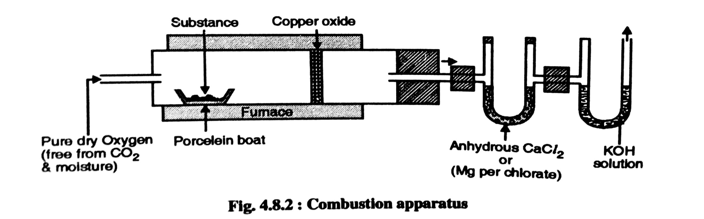
Estimation of carbon and hydrogen
The moisture and CO₂ liberated by heating the coal sample are absorbed by pre-weighed anhydrous CaCl2 and KOH placed in U-tubes. Increase in weight in each case is recorded.

Slide 20
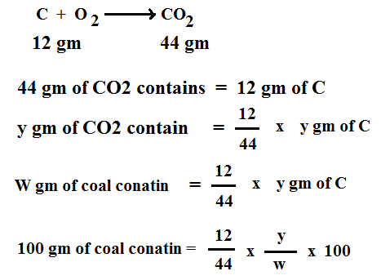


Slide 21
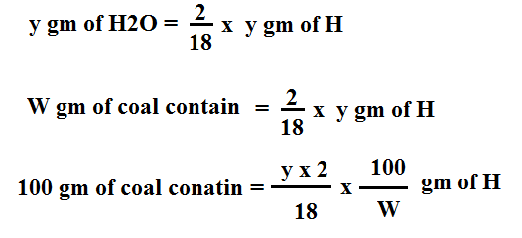
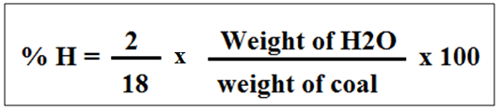
H%
18 gm of H2O = 2 gm of H

Slide 22
% C = Increase in weight of KOH x 12 x 100
weight of coal x 44
% C = Weight of CO2 formed x 12 x 100
weight of coal x 44
Similarly,
% H = Increase in wt of CaCl2 x 2 x 100
weight of coal x 18
% H = weight of H2O formed x 2 x 100
weight of coal x 18
0.25 gm of coal sample on burning in combustion chamber in the current of pure O2 was found to increase of Cacl2 U tube by 0.08 gm. hence % H present in the coal is………
2.02 gm of the coal is burnt in combustion tube. On passing the O2 increases the weight of KOH tube by 5.88 gm. Hence % C present in the coal is ……

Slide 23

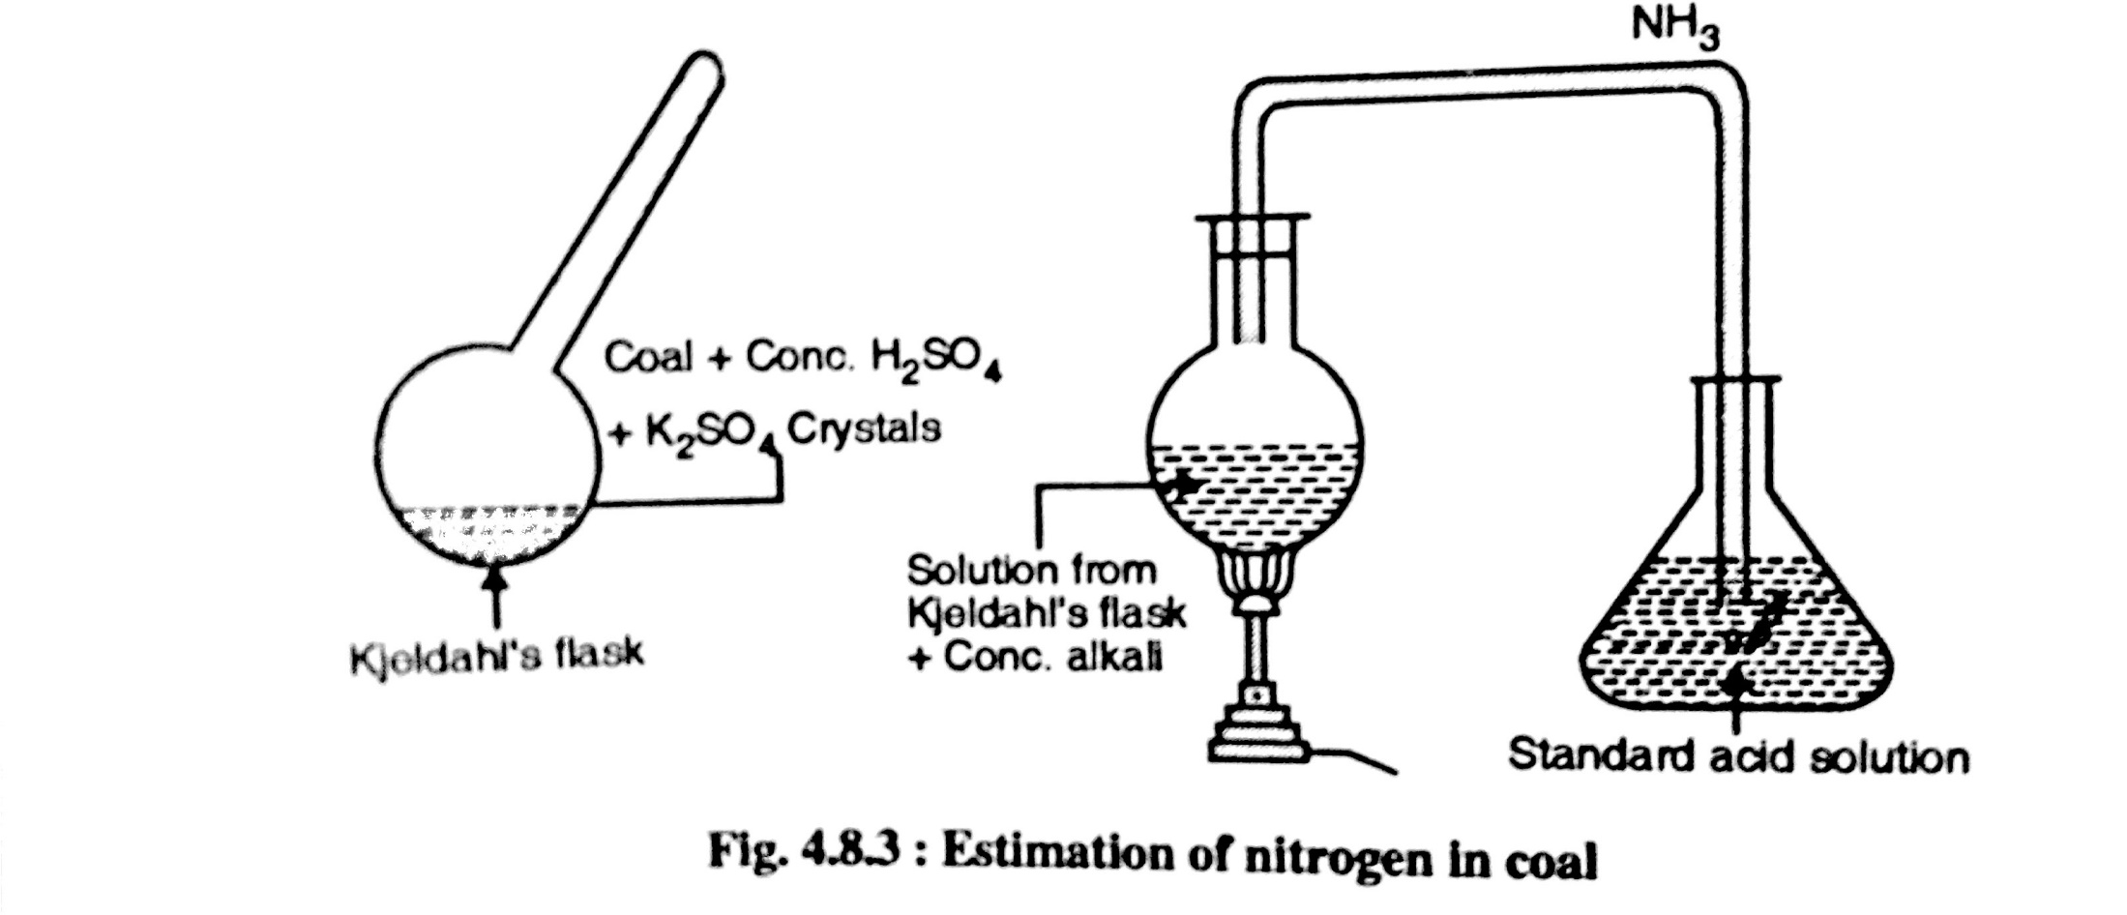
% Nitrogen by Kjeldahl’s method

Slide 24

The unused acid is then determined by titrating with NaOH. From the volume of acid used by NH3 liberated, the percentage of nitrogen can be calculated. The volume of NaOH required is same as the volume of unreacted acid in the conical flask. Thus volume of acid can be determine.
Mass of coal = m gm
V₂ ml = Blank titration reading
V₁ ml = Back titration reading
Volume of acid consumed by NH₃ = (V₂-V₁) ml
1 gm of a coal sample in Kjeldahl’s experiment liberated ammonia which was absorbed in 50 ml H2SO4. the resultant solution required 14 ml 0f 0.1 N NaOH for the complete neutralization of H2SO4 in back titration. The reading of blank titration was 25 ml. hence the % N in coal was………….

Slide 25

% Sulphur by Eschka method
Sulphur present in coal first converted into SO3, which is soluble in water forming H2SO4.
H2SO4 + BaCl2 → BaSO4 ↓
A white precipitate of BaSO4 is obtained
Filter the precipitate of BaSO4, dry it and weigh the precipitate of BaSO4, from the weight of BaSO4 ppt , S% can be calculated.
0.55 gm of coal is combusted in bomb calorimeter on combustion the solution from the bomb on treatment with BaCl2 forms 0.025 gm BaSO4 therefore % S in the coal is….

Slide 26
% Oxygen and % Ash
% Ash is determined by proximate analysis
Ash: Coal contains inorganic mineral substances which are converted into ash by chemical reactions during the combustion of coal.
Ash usually consists of silica, alumina, iron oxide and small quantities of lime, magnesia etc.
Ash content is determined by heating the residue left after the removal of volatile matter at 700 ± 50ºC for ½ an hour without covering
% O₂ = 100 – (% C+ % H+ % S + % N+ % Ash)

